Slide 1


LEAGUE OF GRAPH

Slide 2

DEFINITION OF LIFE EXPECTANCY
Life expectancy is define average period that a person may expect to live

Slide 3
MAIN GOAL
Identify the relationship between different factors and life expectancy
Cleaning data that have missing values
Analyse the data

Slide 4
Cleaning data
First, I changed those countries with value to the mean and mode for categorical values such as BMI
Second, due to some countries data missing , I fill NaN values base on additional data
(This are the files used: Population file used,Hepatitis B used,GDP file used

Slide 5

What are the top 3 countries with highest mean life expectancy ?
As seen from the output above , we can see that San Marino, Japan and Sweden are the top 3 with highest mean life expectancy

Slide 6
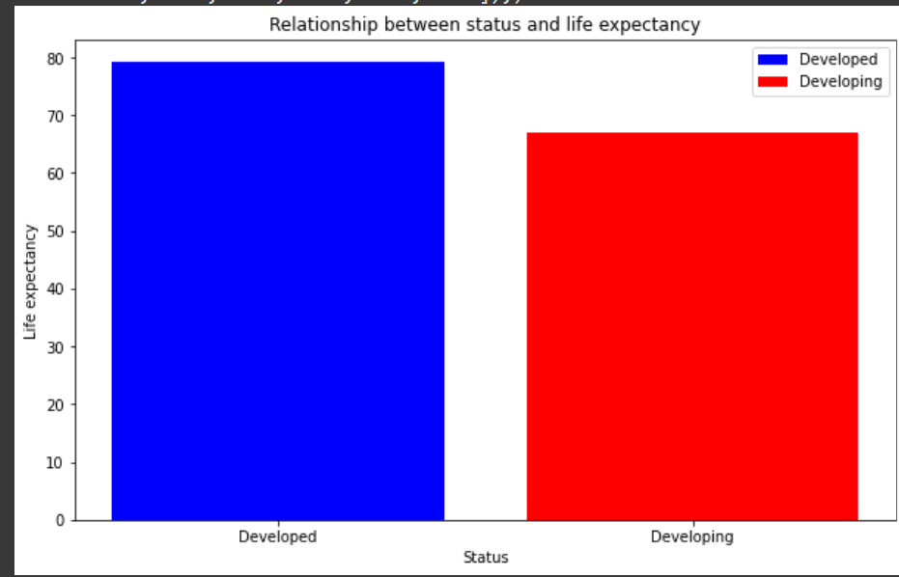
DO DEVELOPED COUNTRIES HAS A HIGHER LIFE EXPECTANCY COMAPRED TO DEVELOPING COUNTRIES ?
Base on the graph on the left, we can see that developed countries do have a higher life expectancy as compared to developing countries

Slide 7

HOW MANY COUNTRIES ARE DEVELOPED IN 2015?
From the data above , we can see that there are 153 countries who are developing
Only 31 countries that are developed in 2015

Slide 8
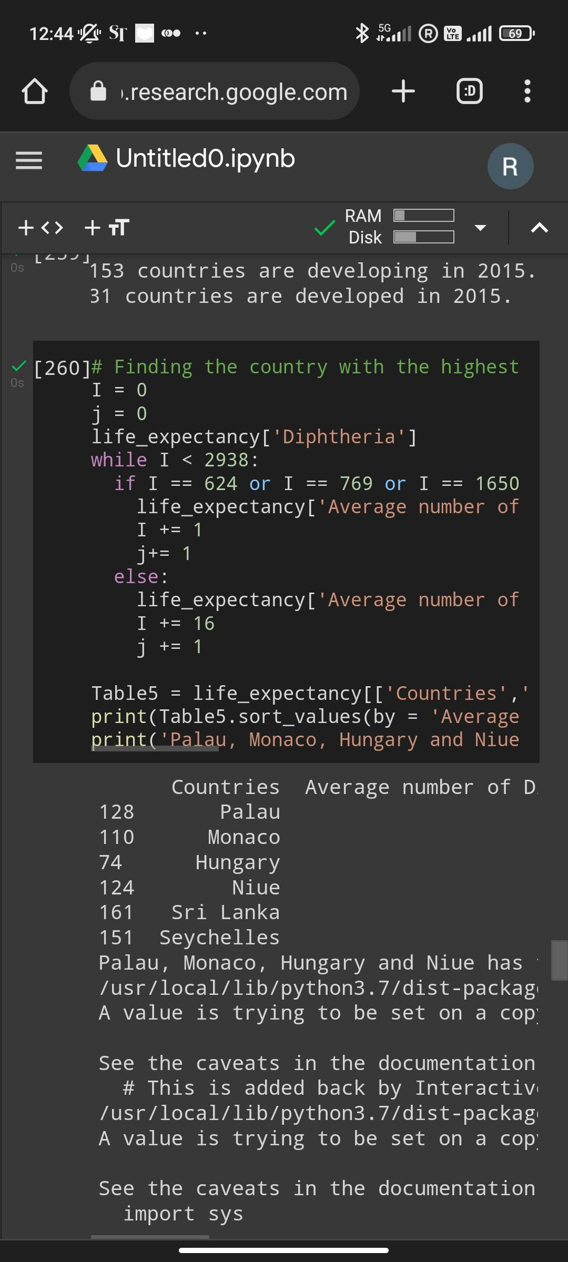
COUNTRIES WITH THE HIGHEST MEAN DIPHTHERIA
As from the graph above , we can see that Palau , Monaco and Hungary has the highest Mean diphtheria

Slide 9

GDP BARRIER
From the data above, the above data is the mean for developed country while the bottom is the mean for developing country , therefore above a GDP of 20000 is likely the GDP Barrier r developed country

Slide 10

ADDITIONAL DATA ANALYSIS

Slide 11
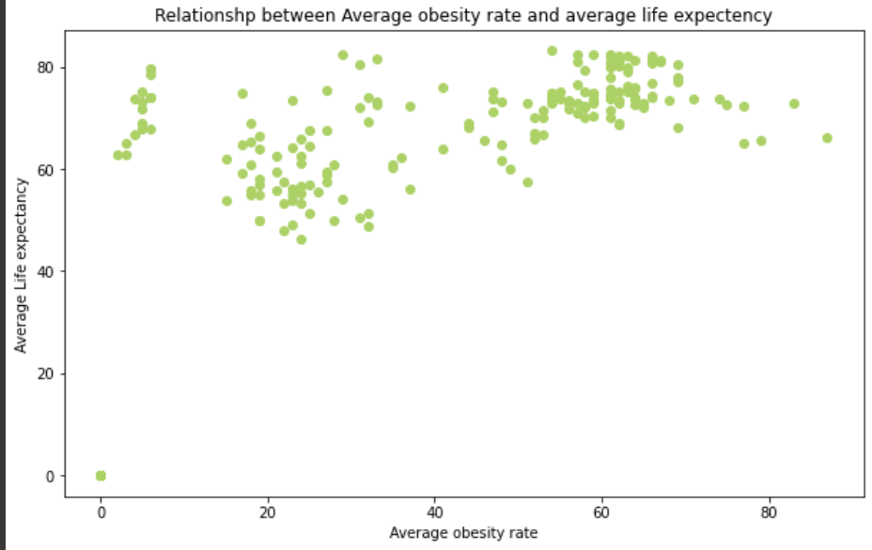
Is their a relationship between the obesity rate and the life expectancy?
From the graph beside, we can see that there isn't much correlation between the life expectancy and obesity rate (BMI)

Slide 12
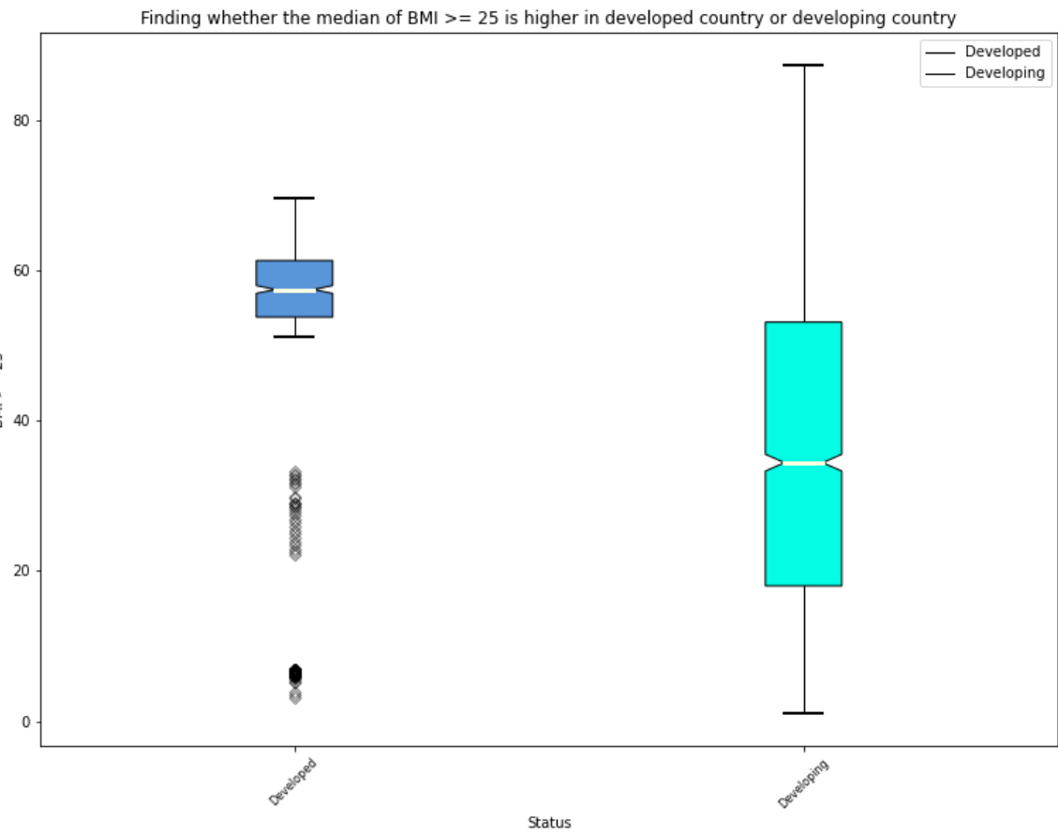
Is the meadian BMI higher in developed country or developing country ?
From the graph beside, we can see that the median BMI for developed country is higher as compared to developing countries

Slide 13
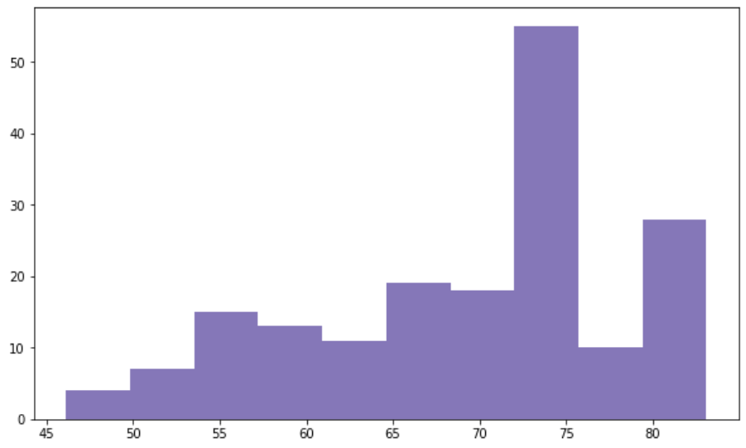
What is the distribution of average life expectancy across the world ?
As seen from the graph beside , we can see that from 72.5 to 75 years old, it has the highest number of countries with mean life expectancy in this range

Slide 14
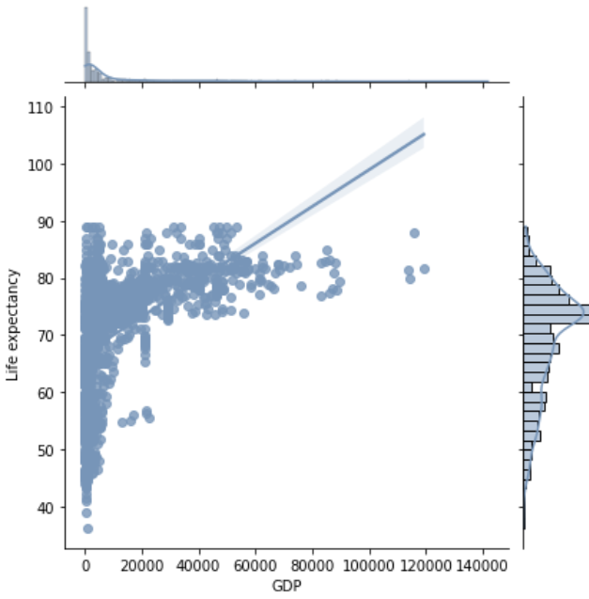
What is the relationship between life expectancy and GDP ?
As seen from the linear regression beside, we can see that Life expectancy is directly proportional to GDP
Additionally , we can see that there is extreme outliers with high GDP but underwhelming life expectancy

Slide 15
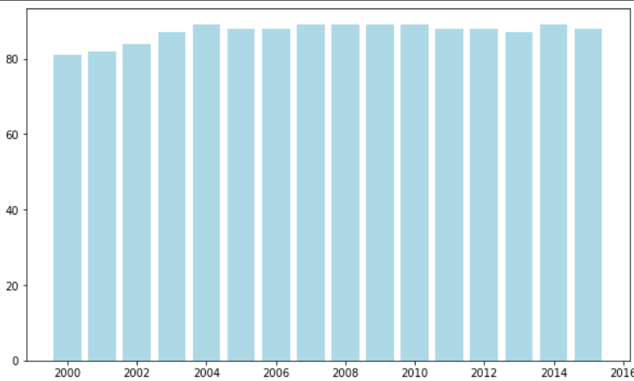
Did the life expectancy increase from year 2000 to 2015 ?
As seen from the graph beside , we can see that the life expectancy did increase steadily from 2000 to 2004 before stabilising

Slide 16
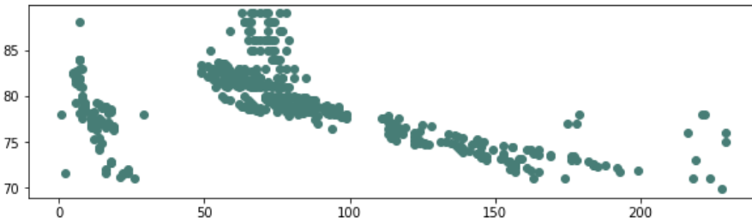
Do the adult mortality have an impact in the life expectancy of a country ?
From the scatter plot graph beside we can see that the life expectancy is inversely proportional to the adult mortality

Slide 17
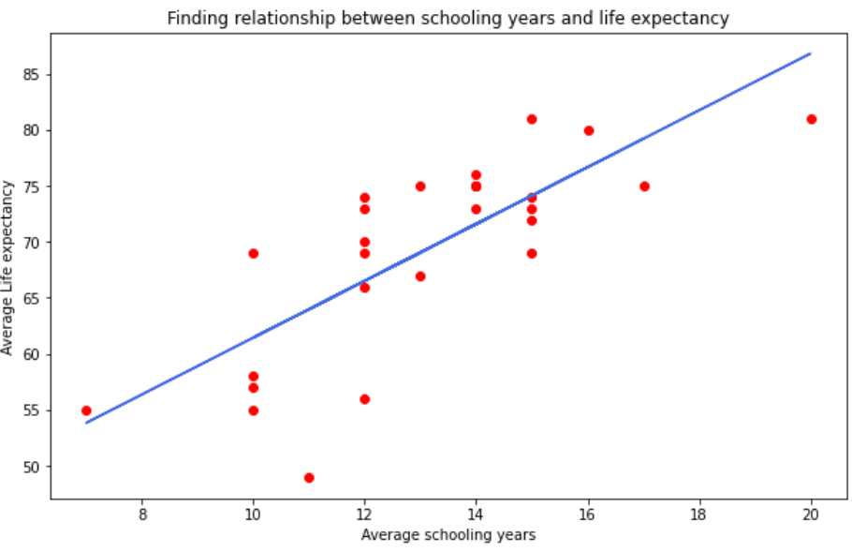
Do the number of schooling years impact the life expectancy ?
From the graph beside, we see that there is a direct relationship between schooling years and life expectancy

Slide 18
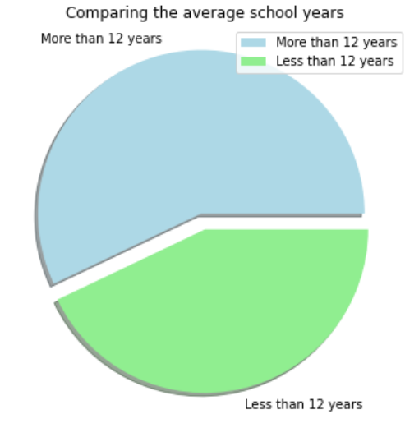
Is their more countries with more than 12 years of compulsory education or less than 12?
From the graph beside , we see that there are more countries with more than ,12 years of compulsory education

Slide 19

Thank you

Slide 20

Extra resources
https://data.worldbank.org/indicator/SP.POP.TOTL
https://ourworldindata.org/grapher/hepatitis-b-incidence-sdgs
https://data.worldbank.org/indicator/NY.GDP.PCAP.CD
https://countryeconomy.com/demography/life-expectancy/san-marino

